Slide 1
WELCOME

Slide 2

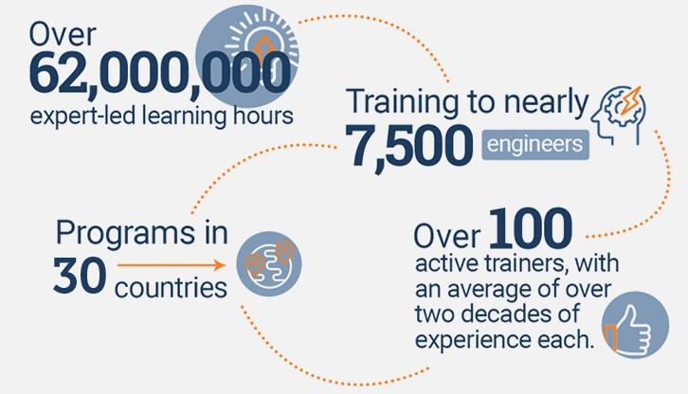
An Overview
Our purpose…
We help organizations learn and adopt new technologies.
In 2018 alone...
…Impacts you daily.
When you talk on the phone, watch a movie, connect with friends on social media, drive a car, fly on a plane, pay with a credit card, shop online, and order a latte with your mobile app, you are interacting with technology developed by one of our customers.
Notes:
Share a bit about DevelopIntelligence
- As developers you want to learn!
- As a corporation you want your developers to align their learning with your business goals.
- That’s where we come in… Keeping developers current, bringing others up-to-speed … all aimed at moving your business forward!
- We started in 2003 by a Sun Microsystems developer that wanted to help developers level-up and see business better leverage IT

Slide 3
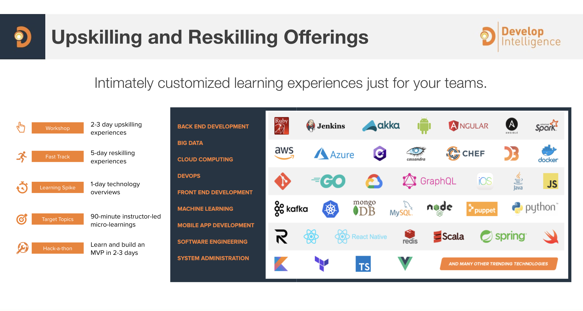
Technologies we cover
Notes:
Areas of DevelopIntelligence expertise
DevOps: Ansible / Jenkins
BigData: Hadoop / Cassandra / Spark
Machine Learning
Front-end: React / Angular
Cloud: AWS / Azure / Google Cloud
- Started as a Java shop -> keep growing -> haven’t looked back
- Our specialty is hiring expert practitioners that can come alongside teams and teach them how to move forward

Slide 4
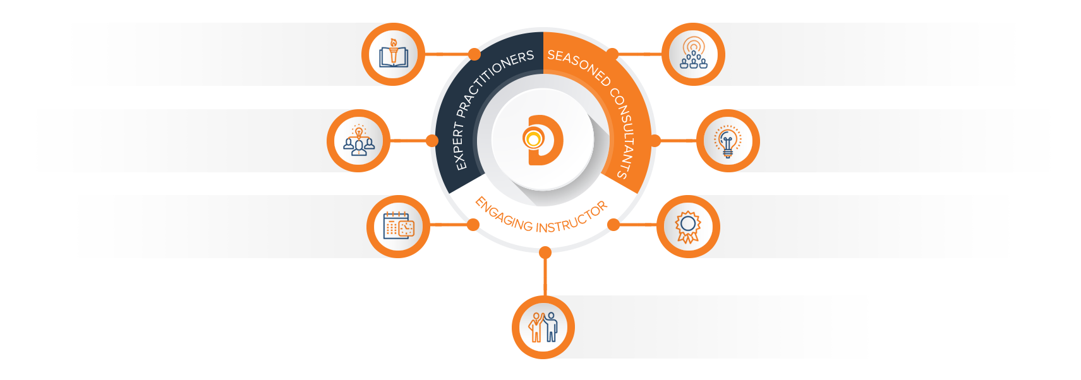
Our Practitioners
250 best selling
books authored
150 engagements speaking
at industry conferences
9+ years of training
experience
Over 17 years of industry
experience per instructor
750,000 practitioner led
training hours
125 certifications in leading
technologies
95% instructor satisfaction

Slide 5

About the instructors

Slide 6
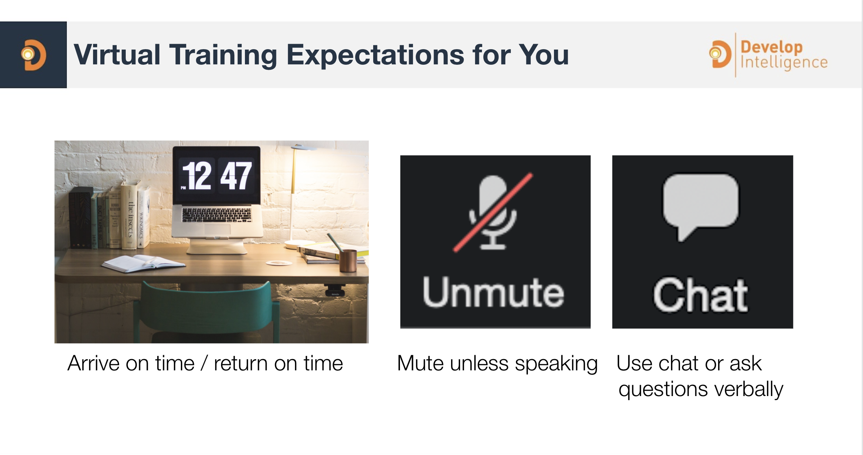

Slide 7
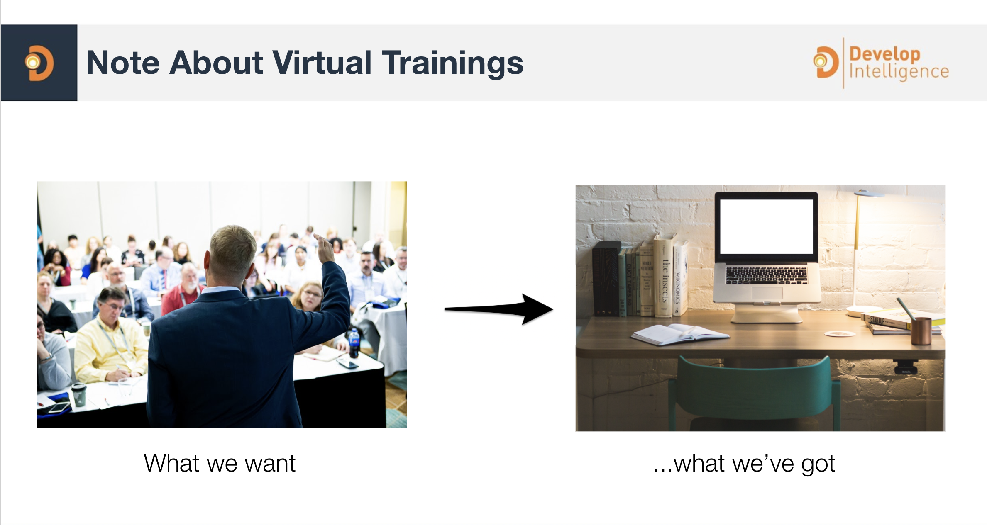

Slide 8
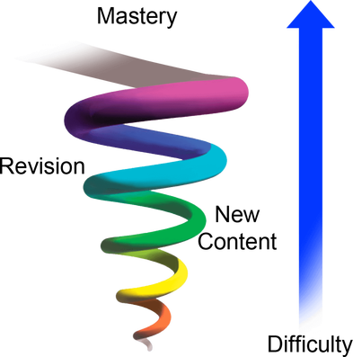
Spiral Approach
Revisiting content to get a better understanding
Increasing difficulty each time
If I am going too fast please let me know
Please ask questions
I encourage discussions on items that interest you
Notes:
There is a lot of material to cover and I have clearly added notes to most of the slides. I encourage discussions to happen around items that interest you! This class if for your Org on how it can be beneficial to you.
I pledge to:
Make this as interesting and interactive as possible
Ask questions in order to stimulate discussion
Use whatever resources I have at hand to explain the material
Try my best to manage verbal responses so that everyone who wants to speak can do so
Use an on-screen timer for breaks so you know when to be back

